Slide 1

VARDHAMAN COLLEGE OF ENGINEERING, HYDERABAD Autonomous institute affiliated to JNTUH DEPARTMENT OF COMPUTER SCIENCE & ENGINEERING
Title: IPL Score Prediction using Deep Learning
BATCH ID : 22MPCS-A06
S. No | Roll. No | Student Name
1 | 22881A0542 | P.Varun Teja
2 | 22881A0562 | V.Sujith
3 | 23885A0502 | G.Parinitha
Guide Details
Mrs Swetha Rame
Assisstant Proffessor
Department of CSE

Slide 2
Mini Project Review-2 Outlines
Main idea of the Project
Existing System Vs Proposed
Proposed Project Objectives
Proposed Project Outcomes
Software and Hardware Requirements
Process Model
Design Phase
Architectural Diagram [Modified]
[UML Diagrams or Data Flow Diagrams] and ER-Diagrams ; It should be detailed diagrams
Proposed Method s and Algorithms [ With example]

Slide 3
Main idea of the Project
The main objective of this project is to utilize deep learning techniques, specifically Long Short-Term Memory (LSTM) networks, to predict accurate scores in IPL matches. The process begins with collecting and preprocessing historical IPL match data, which includes key factors such as team composition, individual player performance, and match conditions. The LSTM model is then trained on this sequential data to capture temporal patterns and dependencies that influence match outcomes. The aim is to build a robust predictive model capable of forecasting IPL scores with high accuracy, offering valuable insights for sports analytics applications.By effectively modeling the time-series nature of the data, LSTM networks can learn long-term dependencies that traditional models often overlook. This predictive system can also aid in strategic decision-making for teams, analysts, and enthusiasts.

Slide 4
Existing System Vs Proposed
In the existing system, score prediction in IPL matches is typically based on statistical models or conventional machine learning algorithms. These approaches often rely on features such as past team performance, individual player statistics, and match conditions to generate predictions. However, they may struggle to fully capture the sequential and temporal nature of cricket match data.
In the proposed system, advanced deep learning techniques—specifically Long Short-Term Memory (LSTM) networks—are employed for score prediction. LSTM models are well-suited for handling time-series data and can learn complex temporal dependencies that traditional models might miss. This enables the model to uncover deeper insights and relationships within the data, potentially leading to more accurate and dynamic score predictions.
Overall, the proposed system aims to enhance the precision and reliability of IPL score prediction by leveraging the sequential learning capabilities of LSTM networks, offering improved performance over traditional methods.
DEPARTMENT OF CSE MINI PROJECT REVIEW-2

Slide 5
Proposed Project Objectives
This project aims to develop a highly accurate deep learning model for predicting IPL team scores using historical match data. It focuses on analyzing crucial factors such as batting order, pitch conditions, and opposition strength to enhance prediction accuracy. A key objective is to enable real-time score estimation, allowing the system to dynamically update predictions as the match progresses.
To achieve optimal performance, various deep learning architectures—including LSTM networks, Convolutional Neural Networks (CNNs), and Transformers—will be explored and evaluated. The project also includes the development of a user-friendly interface, enabling easy access to predictions for both analysts and enthusiasts.
Emphasis will be placed on effective feature engineering and data preprocessing techniques to improve model reliability and generalization. By comparing the performance of deep learning models with traditional machine learning approaches, the project aims to demonstrate superior predictive capabilities. Ultimately, this system seeks to advance cricket analytics by providing actionable insights for teams, coaches, and analysts, helping them make more informed strategic decisions.

Slide 6
Proposed Project Outcomes
Real-Time Score Estimation & Model Optimization Implement real-time score prediction capabilities that dynamically update as match data evolves. Optimize and compare various deep learning architectures—including LSTM networks, CNNs, and Transformers—to identify the best-performing models.
Comparison with Traditional Methods & Enhanced Analytics Evaluate and benchmark deep learning models against traditional machine learning techniques to validate improved prediction accuracy and extract actionable insights for coaches, analysts, and team strategists.
User-Friendly Interface & Future Scalability Design and develop an intuitive, web-based or mobile application interface to provide seamless access to score predictions. Ensure the system is scalable, with future extensions to predict win probabilities, player performance metrics, and other match outcomes.

Slide 7
Software and Hardware Requirements
Software Requirements:
Programming: Python (TensorFlow, Keras, PyTorch, NumPy, Pandas)
Development: Jupyter Notebook, Google Colab, PyCharm
Database: MySQL, PostgreSQL, CSV files
Frameworks: TensorFlow, Flask/Django for deployment
Visualization: Matplotlib, Seaborn, Tableau/Power BI
Cloud (Optional): AWS, Google Cloud, Azure
Hardware Requirements:
Processor: Min. Intel Core i5 (Recommended: i7 or higher)
RAM: Min. 8GB (Recommended: 16GB+)
GPU: NVIDIA CUDA support (Recommended: RTX 3060 or higher)
Storage: Min. 50GB (Recommended: SSD 256GB+)
Internet: Stable connection for cloud training

Slide 8
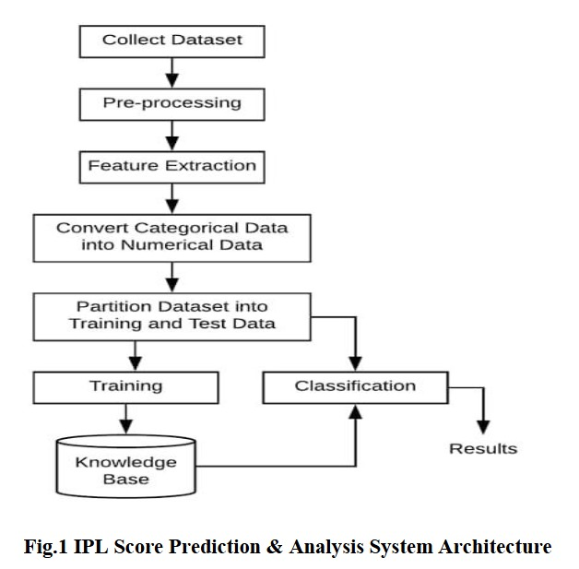
Process Model

Slide 9
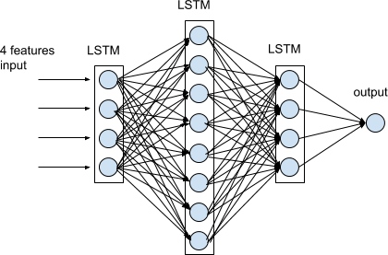
Architectural Diagram

Slide 10
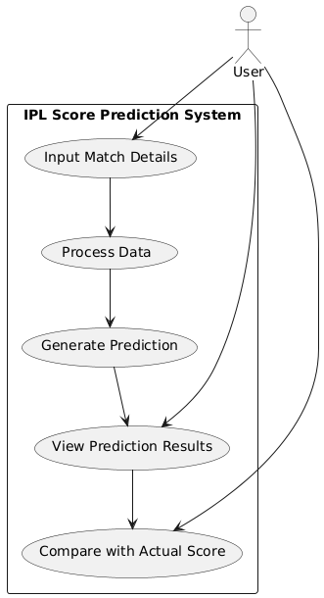
USE CASE DIAGRAM

Slide 11
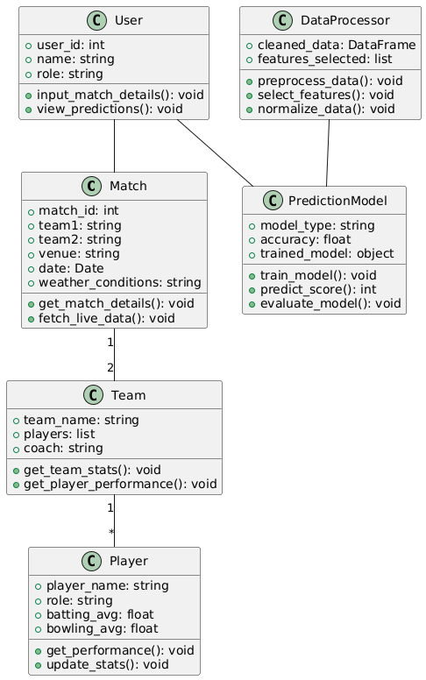
CLASS DIAGRAM

Slide 12
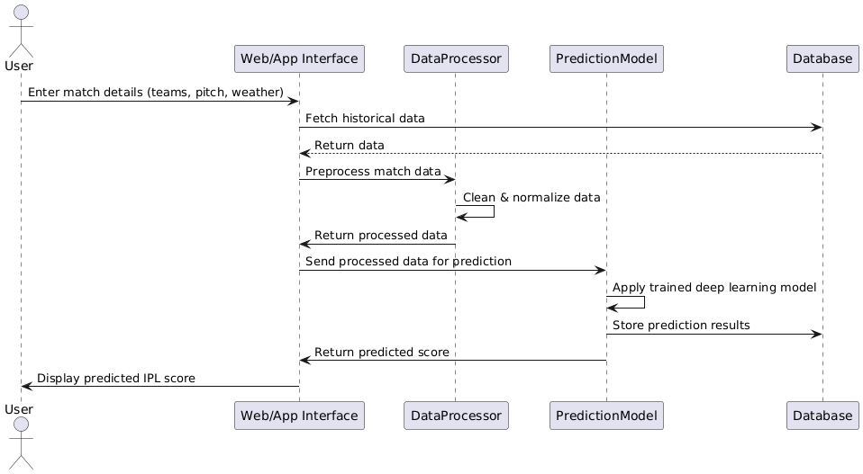
SEQUENCE DIAGRAM

Slide 13
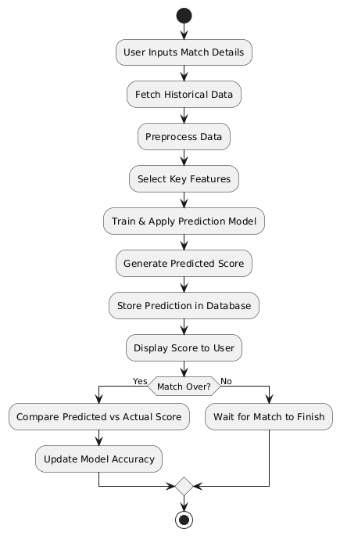
ACTIVITY DIAGRAM

Slide 14
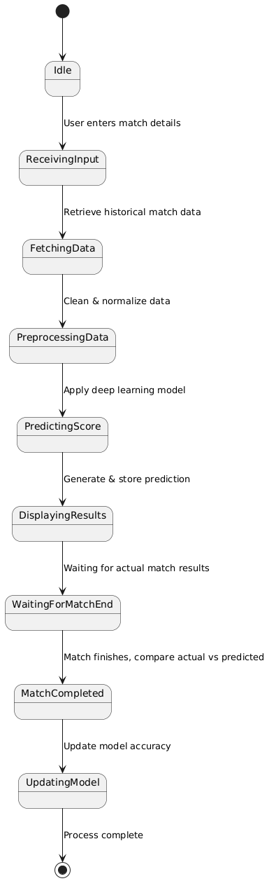
STATE CHART DIAGRAM

Slide 15
PROPOSED METHOD AND ALGORITHMS
. Data Preprocessing & Feature Selection
Clean, normalize, and transform match data.
Convert categorical features (team, venue) using One-Hot Encoding.
Select key features like run rate, wickets, and batting order using correlation analysis.
2. Deep Learning Model (LSTM)
Convert match data into a time-series format.
Train an LSTM model with historical IPL data.
Optimize model using loss function (MSE) and hyperparameter tuning.
3. Model Evaluation
Use MAE (Mean Absolute Error) and RMSE (Root Mean Squared Error) to measure accuracy.
Compare predicted vs actual scores for validation.
4. Model Deployment (Flask API)
Load the trained model and deploy it as an API.
Accept user inputs (match details) and return real-time score predictions

Slide 16
Thank You

